Slide 1

Java Servlets
Cairo University
Faculty of Engineering
Computer Engineering Department
CMP(N) 306 - Advanced Programming Techniques
Notes:
A servlet is simply a class which responds to a particular type of network request - most commonly an HTTP request. Basically servlets are usually used to implement web applications - but there are also various frameworks which operate on top of servlets (e.g. Struts) to give a higher-level abstraction than the "here's an HTTP request, write to this HTTP response" level which servlets provide.
Servlets run in a servlet container which handles the networking side (e.g. parsing an HTTP request, connection handling etc). One of the best-known open source servlet containers is Tomcat

Slide 2
Agenda
What is the problem we are solving?
Which tools are will help us solve it?
How will they help us?
How do we use these tools?
Installation Tutorial
Basic Example Tutorial
Requirement
Notes:
http://docs.oracle.com/javaee/6/tutorial/doc/bnafd.html
https://docs.oracle.com/javaee/6/api/javax/servlet/Servlet.html

Slide 3
The Problem
We want to have a website that has
Static web pages
Dynamic web pages (built by Java)
To do that we need to:
Direct client request to our server
Make the server choose the correct program/page
Write programs that perform the required logic

Slide 4

The Tools We’ll Use
Tomcat
Acts as a container
Receives requests
Channels dynamic ones to the designated programs
Java Servlets
Parses certain requests
Performs logic
Builds the web page at runtime
Returns this web page
Apache Tomcat
Java Servlet
Java Servlet

Slide 5
The Tools We’ll Use In Details: Java Servlets
The Java servlet package offers a framework to make it easy to build servlet apps
Includes the Servlet interface which defines lifecycle methods:
Void init()
Void service(ServletRequest req, ServletResponse res)
Void destroy()
ServletConfig getServletConfig()
String getServletInfo()

Slide 6
The Tools We’ll Use In Details: Java Servlets
Includes the GenericServlet abstract class that implements Servlet:
Implements all Servlet methods except service(ServletRequest req, ServletResponse res)
Includes the HttpServlet abstract class that extends GenericServlet:
Overrides the service method and dispatches the request to other methods (doXXX) depending on type of request

Slide 7
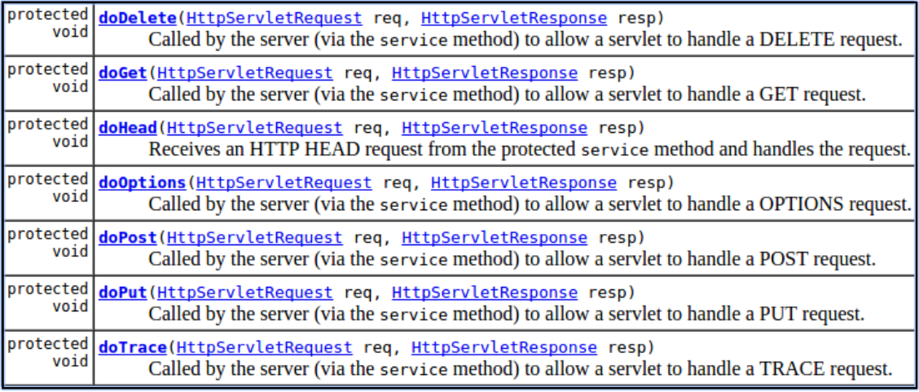
The Tools We’ll Use In Details: Java Servlets

Slide 8
The Tools We’ll Use In Details: Tomcat
Servlets are deployed into this container
Handles the life-cycle
If an instance of the servlet does not exist, the web container:
Loads the servlet class.
Creates an instance of the servlet class.
Initializes the servlet instance by calling the init method.
Invokes the service method, passing request and response objects.
If it needs to remove the servlet, the container finalizes the servlet by calling the servlet’s destroy method.

Slide 9
How To Use These Tools?
Write Java Classes that extend HttpServlet
Override the doXXX method you want
In it:
Get the info you want from the request through the object HttpServletRequest
Perform your logic
Build your html page as a string and provide to to the HttpServletResponse object

Slide 10
How To Use These Tools?
Provide the compiled classes to Tomcat
It will be as simple as putting them in a folder!
Instruct Tomcat about which user requests map to which .class file
This mapping will be done by editing an XML file

Slide 11
Installation & Basic Example
Notes:
https://www.javatpoint.com/servlet-tutorial https://www.geeksforgeeks.org/introduction-java-servlets/ https://stackoverflow.com/questions/7213541/what-is-java-servlet https://tomcat.apache.org/download-10.cgi https://stackoverflow.com/questions/28991391/getting-errorjre-home-variable-is-not-defined-correctly-when-trying-to-run-star

